Slide 1
Endodontics lecture 4
Intracanal instruments
By
Abdullah Mohammed Al Jawher
B.D.S. M.Sc. (conservative)

Slide 2
Rotary Instrumentation systems using Nickel Titanium
1- FIRST GENERATION
Features :
passive cutting radial lands
fixed tapers of 4% and 6% over the length of their active blades.
required numerous files to achieve the preparation objectives.
Example :
GT files (Dentsply Tulsa Dental Specialties)

Slide 3

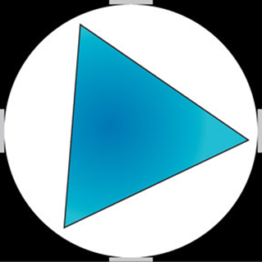
Landed versus non-landed instruments
Landed
non-landed

Slide 5
2- SECOND GENERATION
Features :
Came to market in 2001.
active cutting edges
require fewer instruments
EndoSequence (Brassler USA) and BioRaCe (FKG Dentaire) provide file lines with alternating contact points. (To discourage taper lock )
ProTaper (Dentsply Tulsa Dental Specialties) utilizing multiple increasing or decreasing percentage tapers on a single file.

Slide 6
Pro taper system :
SX ; The diameter at the tip is 0.19 mm. total length of 19 mm
S1; a tip diameter 0.17 mm. available in lengths of 21 and 25 mm.
S2; a tip diameter of 0.20 mm. available in lengths of 21 and 25 mm
(F1) − yellow ring − D0 = 20/100.
(F2) − red ring − D0 = 25/100.
(F3) − blue ring − D0 = 30/100.
(F4) – two black rings − D0 = 40/100.
(F5) − two yellow rings − D0 = 50/100

Slide 7
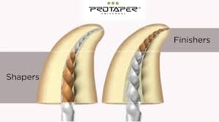
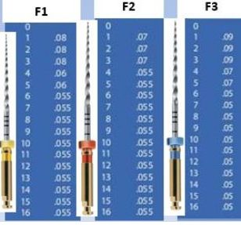
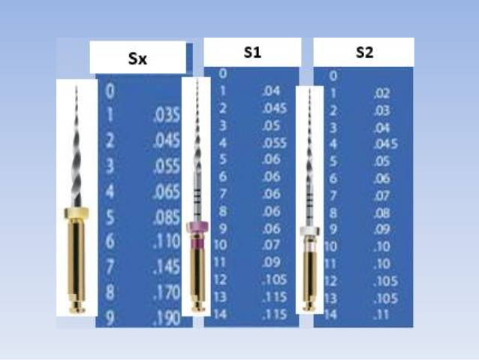
Tapering

Slide 8
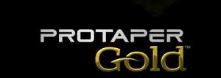
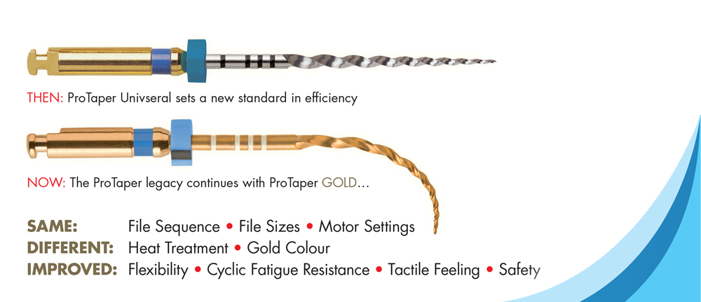

Slide 9
3- THIRD GENERATION
Improvements in NiTi metallurgy ( in 2007 ) became the hallmark of what may be identified as the 3rd generation.
This 3rd generation of NiTi instruments significantly reduces cyclic fatigue and, hence, broken files.
Examples of brand lines that offer heat treatment technology are : Twisted File (SybronEndo), Hyflex (Coltene Whaledent) and WaveOne (Dentsply Tulsa Dental Specialties).

Slide 10
4- FOURTH GENERATION
Utilizes reciprocation
This generation of instruments and related technology has largely fulfilled the long hoped-for single-file technique.
Examples: WaveOne (Dentsply Tulsa Dental Specialties and Maillefer) , Reciproc (VDW)

Slide 11
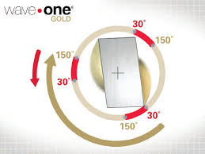
Reciprocation

Slide 12
5- FIFTH GENERATION
center of mass and/or the center of rotation are offset.
Examples:
- Revo-S.
- One Shape (Micro Mega) . - ProTaper Next (Dentsply Tulsa Dental Specialties /Dentsply Maillefer).

Slide 13
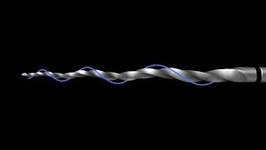

Slide 14
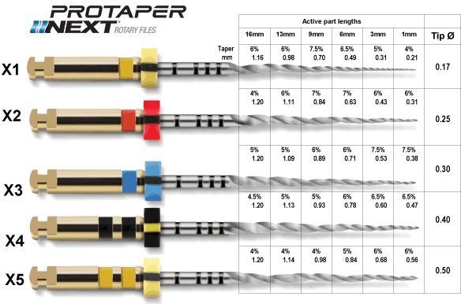

Slide 15
Group IV: Engine-Driven Three-Dimensionally Adjusting Files (Self-adjusting file)

Slide 16
SAF offers us the ability to shape the morphology of individual pulpal
systems in 3-D

Slide 17
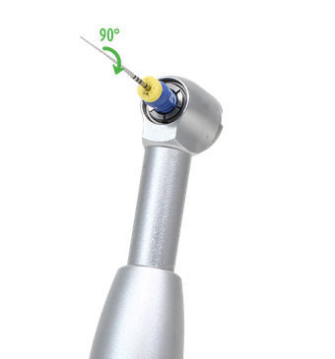
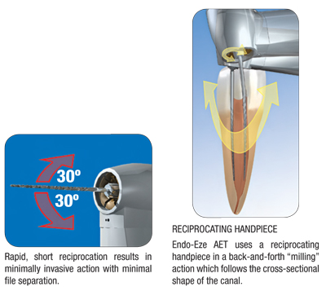
Group V: Engine-Driven Reciprocating Instruments:

Slide 18
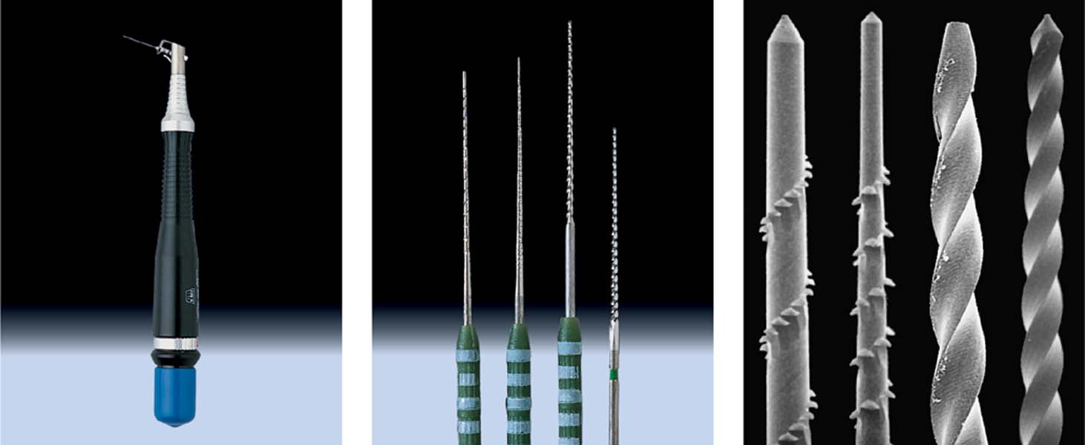
Group VI: Sonic and Ultrasonic Instruments

Slide 19
Thank You

